Slide 1

Surviving car!!!
Introducing
Powered by Koushik Deb and Syeed Abrar Zaoad

Slide 2
Outline(1 of 2)
Before everything started
Surviving Car!!
Game Plan
How to play
Multi-level challenge
Leader board
Game summary
Project summary

Slide 3
Outline(2 of 2)
Project objectives
Project features
Limitation
Resources

Slide 4
Before everything started…
Weren’t sure about what we are going to make.
Had to change the idea of the game many times.
Not quite sure about the name of the game
Had to change the name according to the game.

Slide 5
Surviving car!!
This game is sure to give you an interface to SURVIVE...
You have to stay away from other cars/trucks to keep the game alive
So let’s check how long you can!!

Slide 6
Game plan…
Some vehicle are always coming from the opposite direction.
You have to survive from them as well as to eat “bonus objective”.
You can make your car jump by getting bonus … ;)

Slide 7
How to play??
Arrow key and LShift button is needed
control the player’s object with movements of keyboard.
Mouse is not needed.
.
.
.
That’s all folks!!!(for now)

Slide 8
Multilevel Challenge
Three level of the game.
Last one is Boss level.

Slide 9
Leader Board
After finishing the game, the score is showed, and if it surpasses the high score then the player is asked for his name to keep records of high scores.
No one can play anonymously.

Slide 10
Game Summery
New Game
High score
Credits
Main menu
Game over
Exit
Level 1
Level 2
Level 3

Slide 11


Slide 12
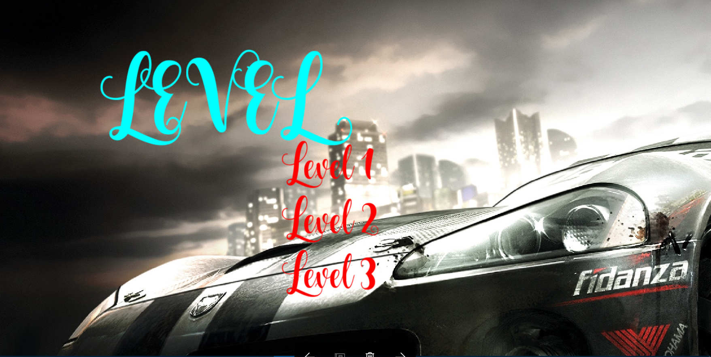

Slide 13
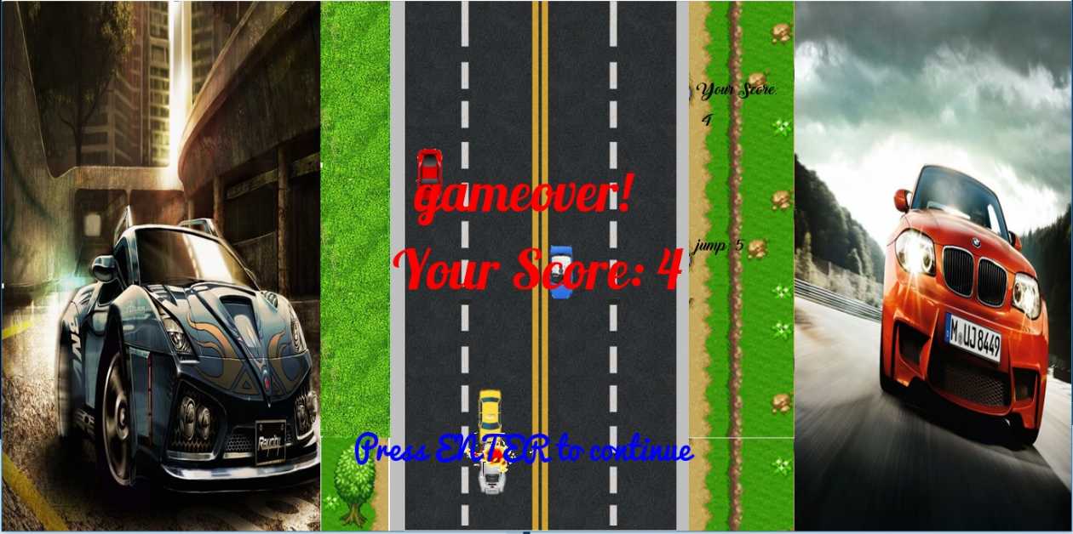

Slide 14


Slide 15
Special Features
Jump;
Sound Effect;
Variety of obstacles(people, vehicles, barricades);
Car blast animation;

Slide 16
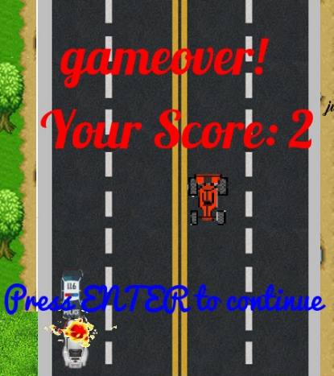
Car blast

Slide 17
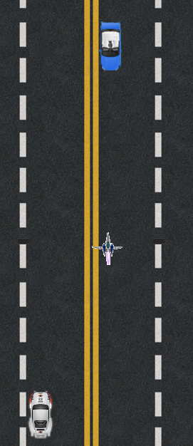
bonus

Slide 18
Project summary
Language: C++
Graphics: SFML
Compiler: Microsoft Visual Studio 2013.

Slide 19
Project objectives
Implementing programming to use graphical interface and to make a user friendly game ultimately.

Slide 20
Project features
Use of modular programming
Algorithm based
User friendly and smooth interface

Slide 21
limitations
Although we tried to make it real smooth, there are still some bugs in the game
Graphics, from our point of view is not rich enough though it fits well.

Slide 22
Resources
Programming in ANSI C By E.Balaguruswami
C++: The Complete Reference By Herbert Schildt
www.google.com
www.en.wikipedia.org

Slide 23
Q & A sec
Any questions??

Slide 24
Thank you!!
happy Surviving!!

